Slide 1
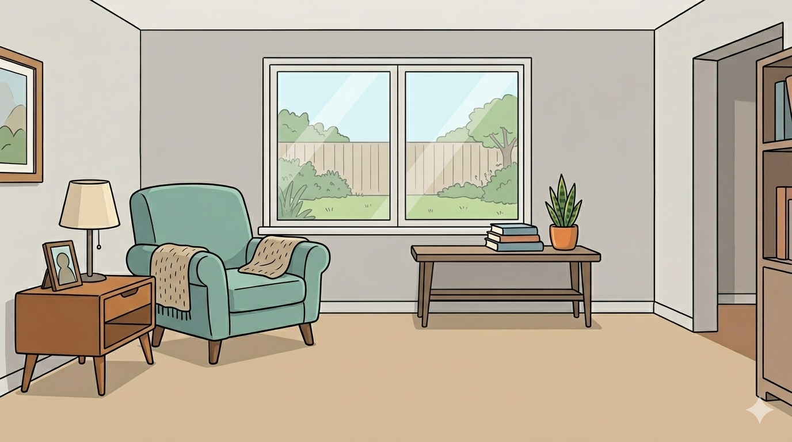
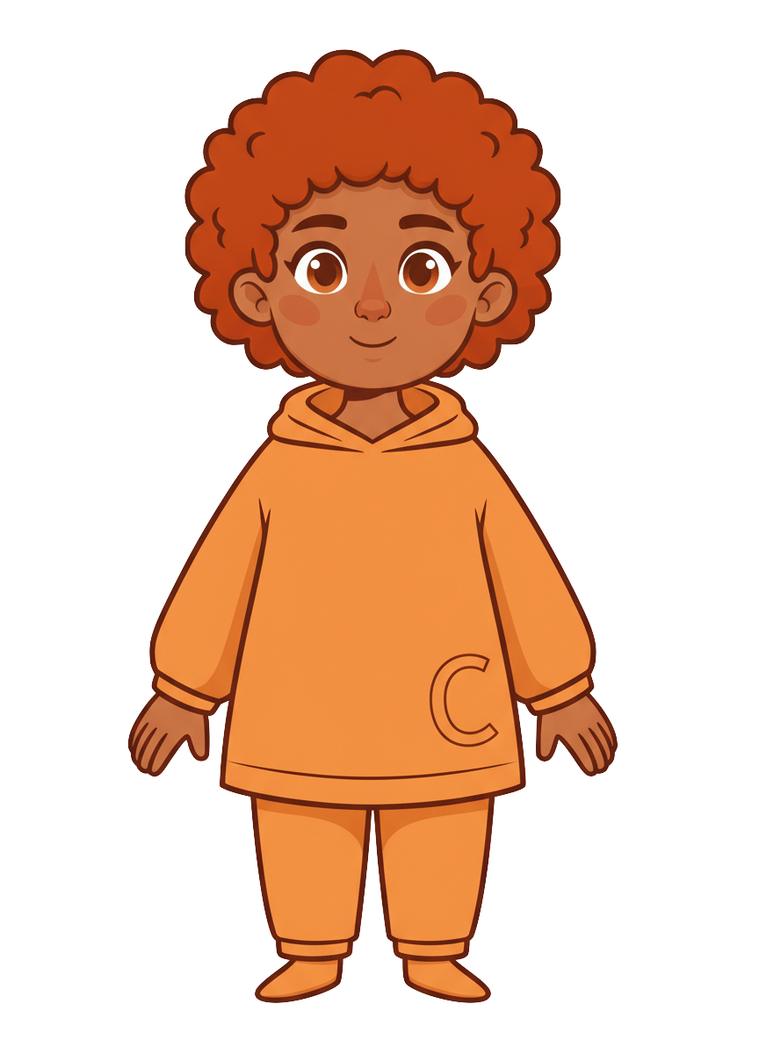
This is Finn.

Slide 2

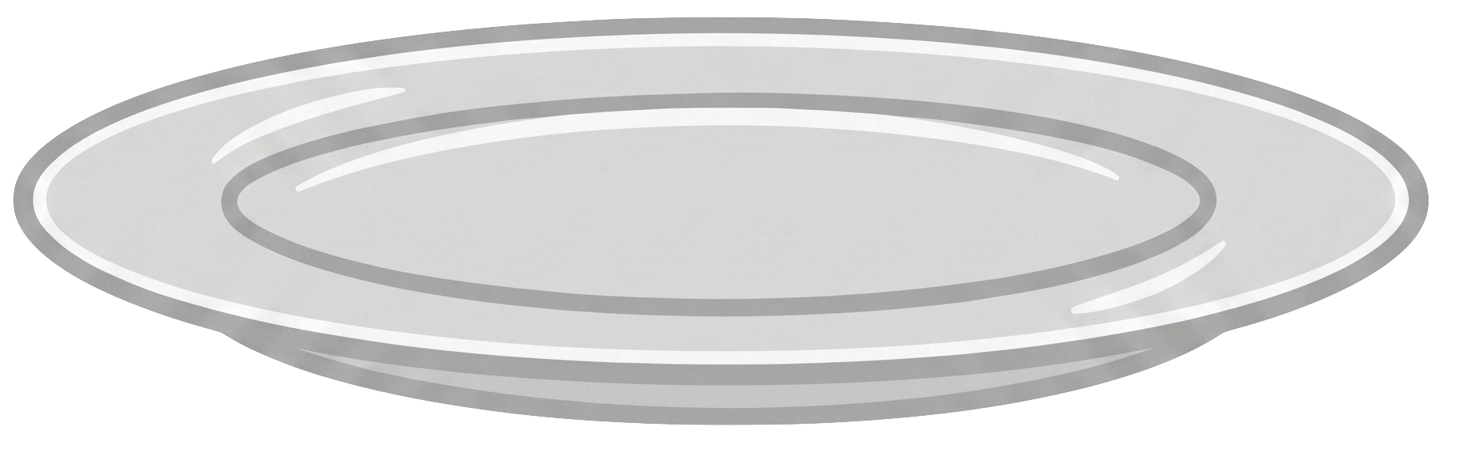
Finn has 5 cookies.

Slide 3
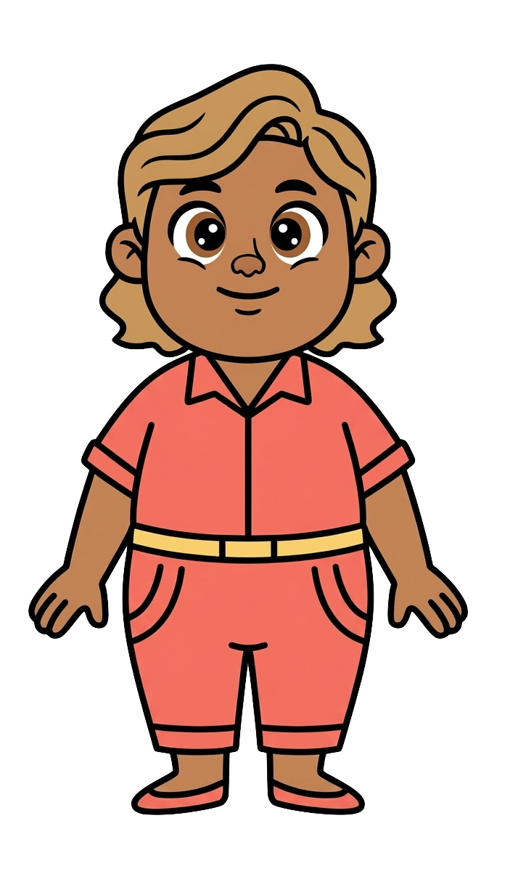
This is Cleo.

Slide 4
Cleo has 5 cookies.

Slide 5
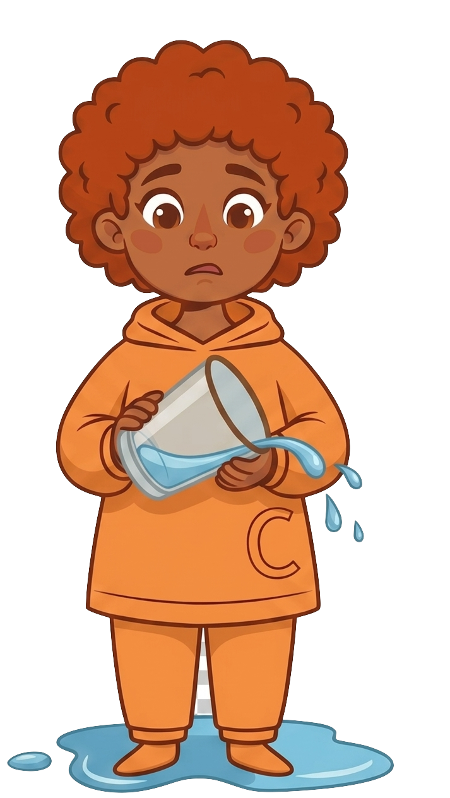
Finn spills water.

Slide 6
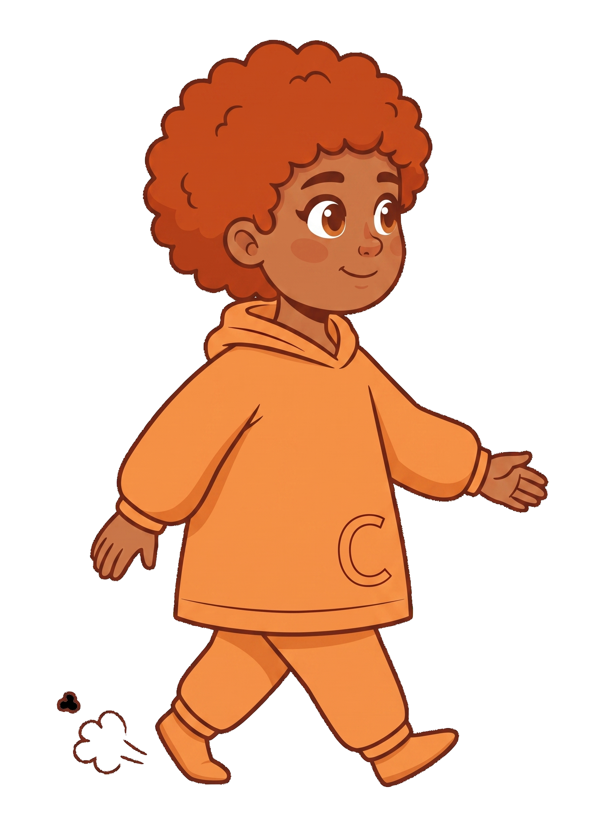
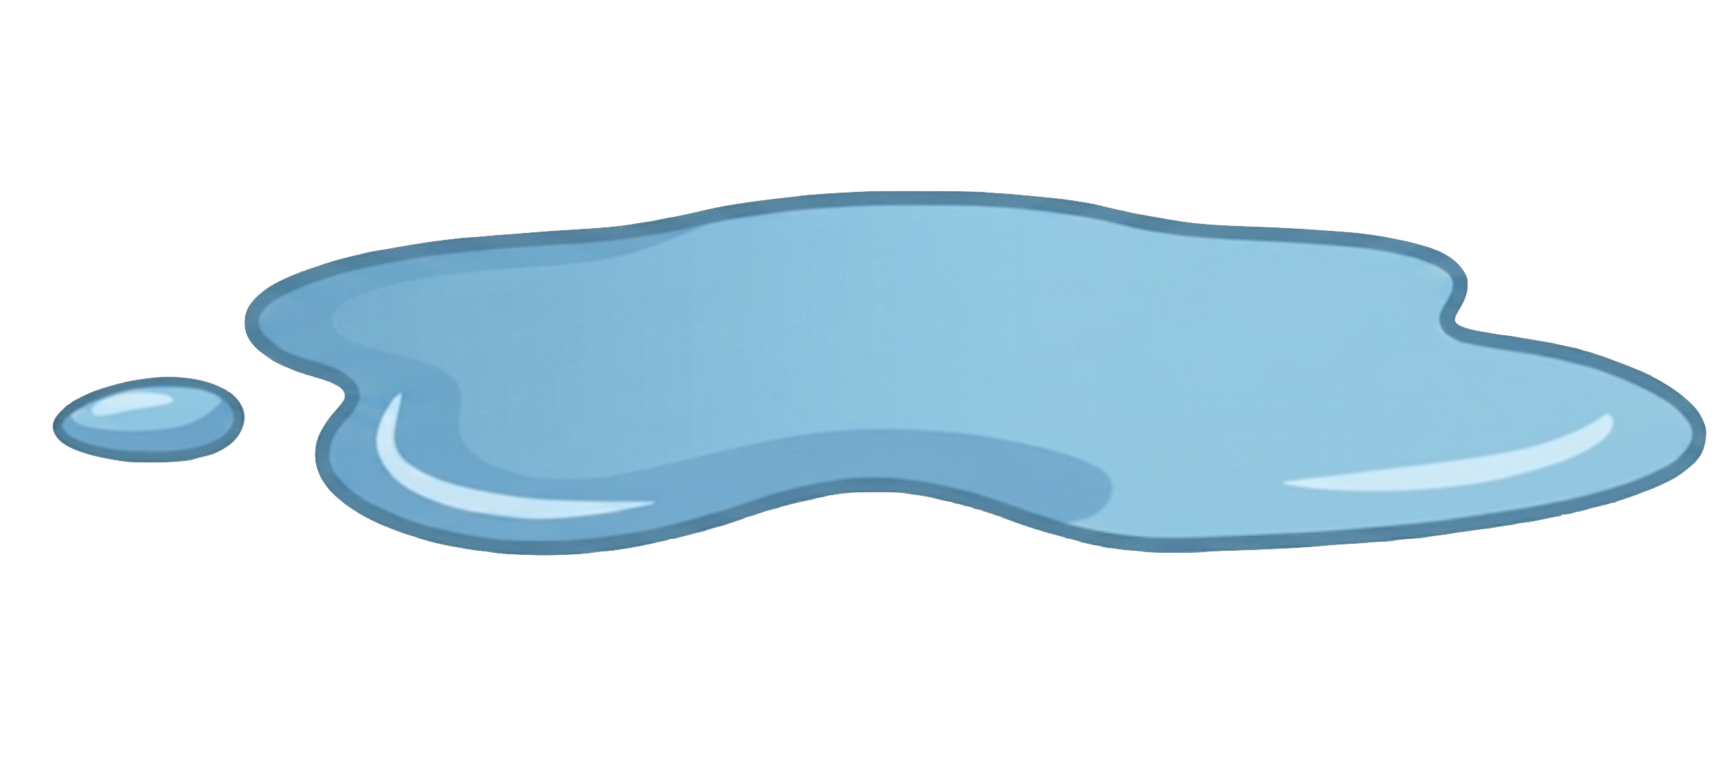
Finn doesn’t clean it up and walks away.

Slide 7
Finn doesn’t clean it up and walks away.

Slide 8
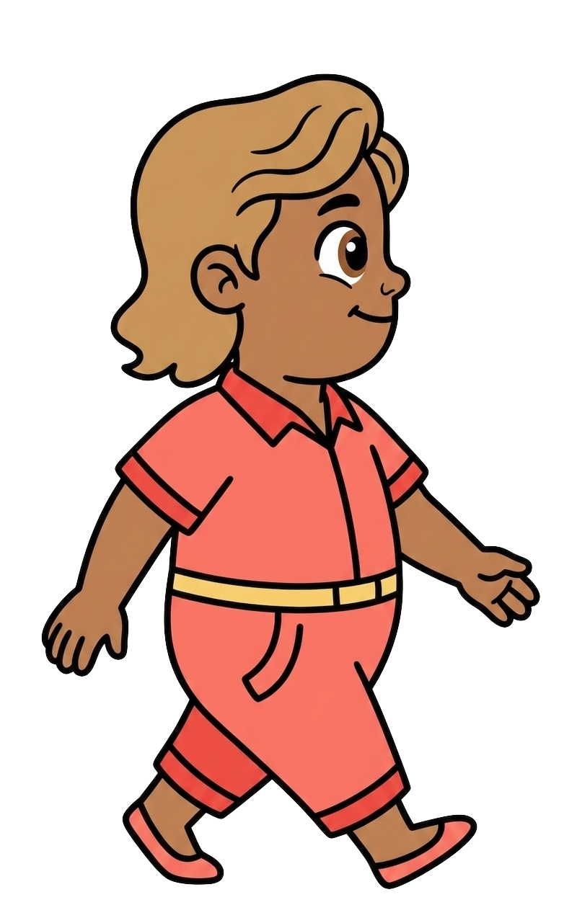
Cleo walks in.

Slide 9
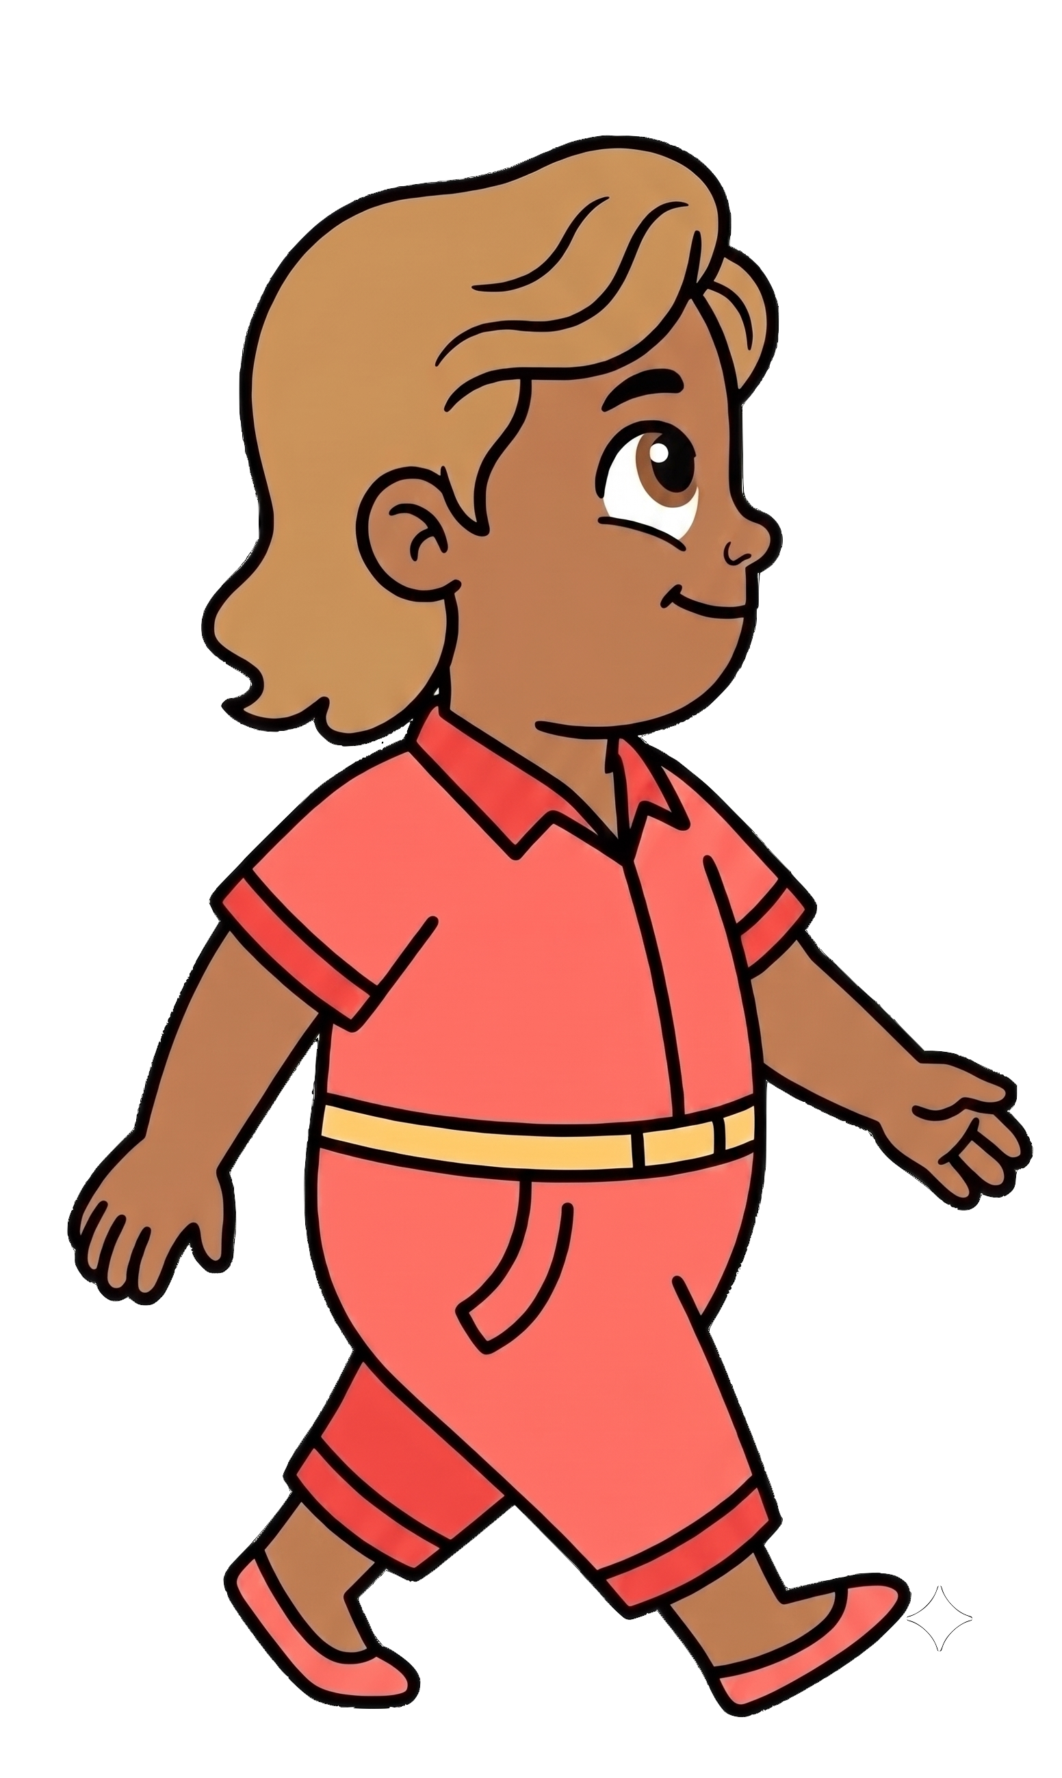
Cleo was not looking where she was going.

Slide 10
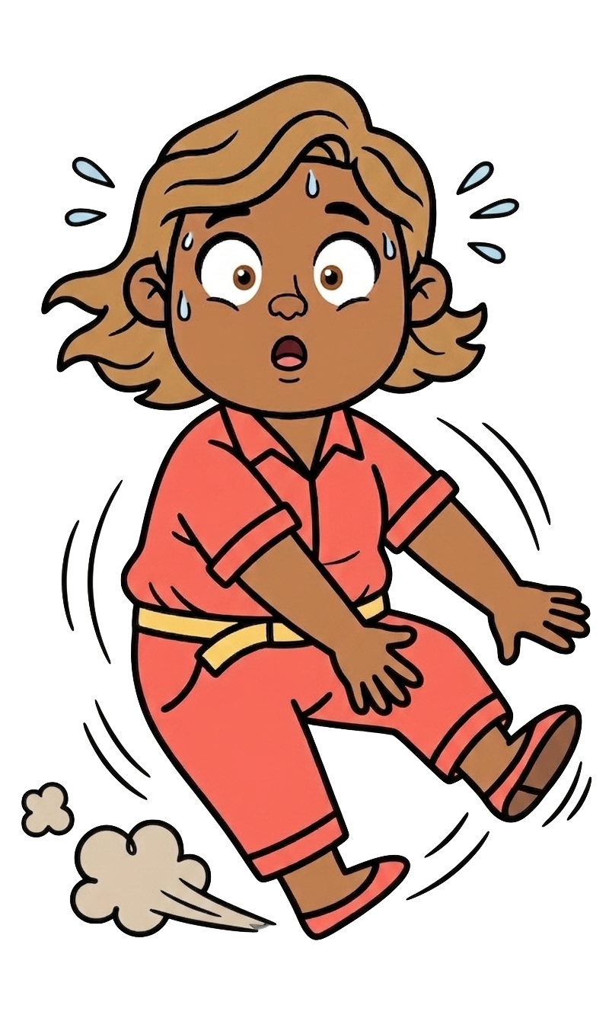
Oh no! Cleo slips on the water!

Slide 11
2 of Cleo’s cookies fall!

Slide 12
Finn still has 5 cookies. Cleo now has 3 cookies.

